Slide 1

Team Diversity “Team diversity refers to the differences between individual members of a team that can exist on various dimensions like age, nationality, religious background, functional background or task skills, sexual orientation, and political preferences, among others.”
Sanjeeva Perera - Senior Academic Fellow
Department of Computer Systems Engineering,
Faculty of Computing

Slide 2
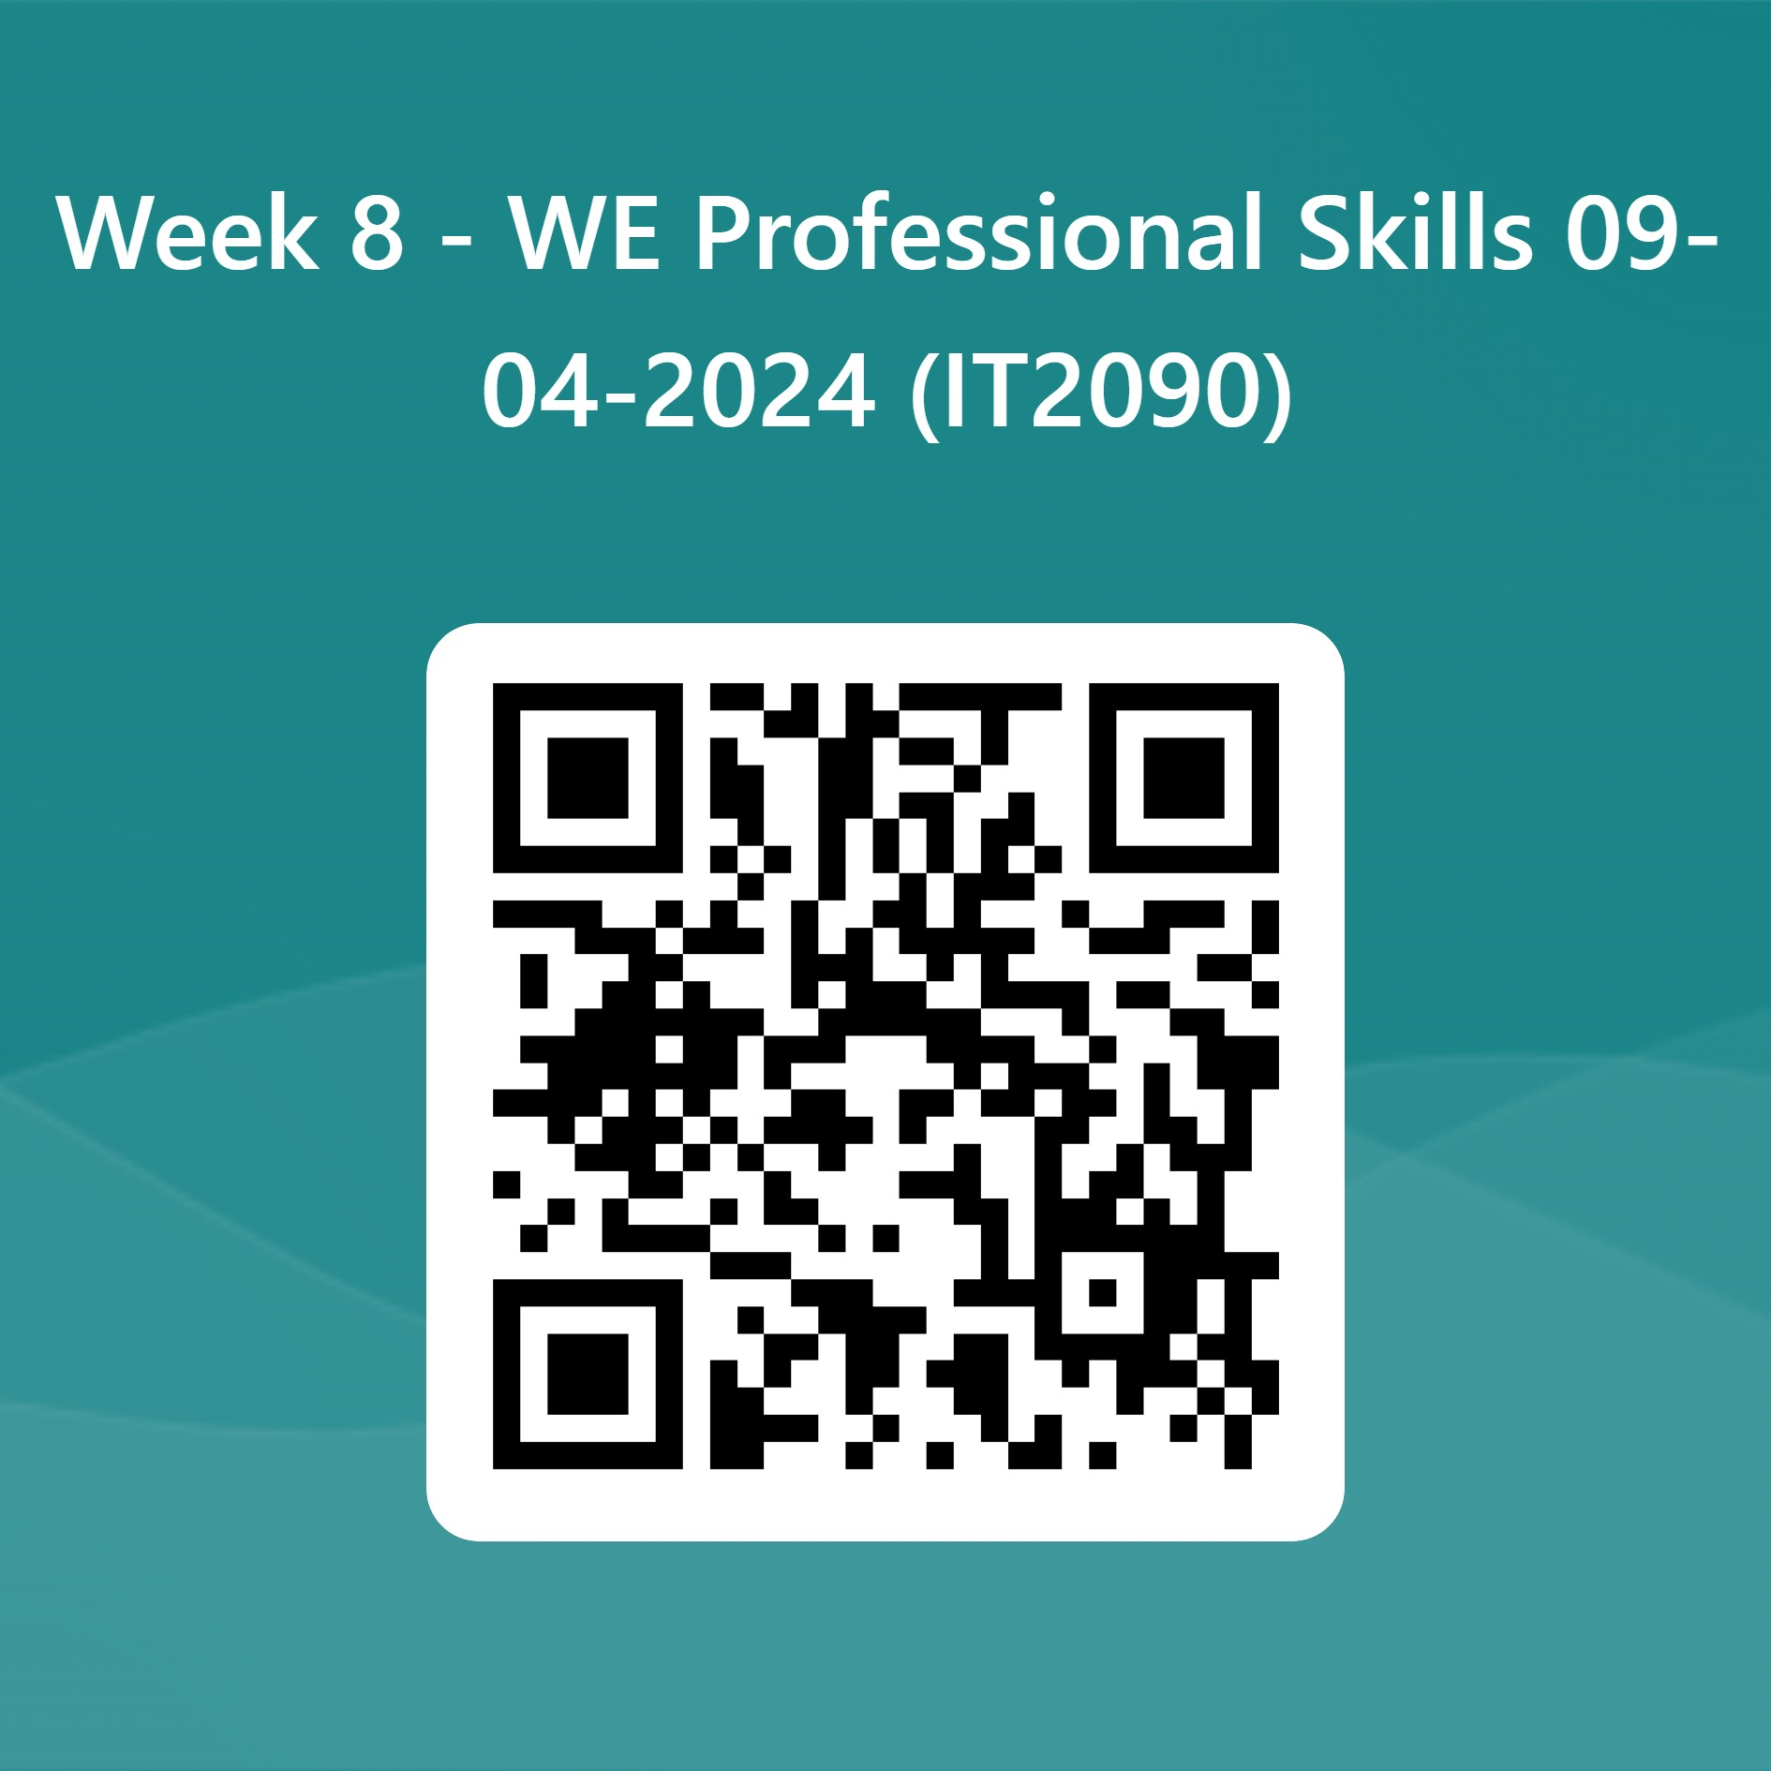
Attendance https://forms.office.com/r/D63N1MWZjJ

Slide 3
TEAM DIVERSITY

Slide 4
Aim of the Lecture
What is team Diversity?
Religious diversity
Gender diversity
Age diversity
National Culture
Benefits of Diversity
Challenges of Diversity

Slide 5
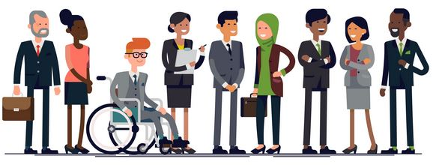
Embracing diversity in teams,
organization and society

Slide 6

Embrace
Embrace: hold (someone) closely in one's arms, especially as a sign of affection
Inclusion is a sense of belonging. Inclusive cultures make people feel respected and valued for who they are as an individual or group.

Slide 7
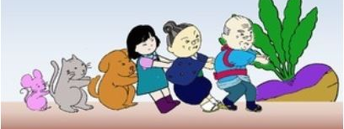
Team Diversity & Performance Video : There’s no I in team. how diversity and inclusion lead to successful teamwork

Slide 8
What is team Diversity?
Team Diversity is the significant uniqueness of each individual on a team
This includes,
Religion
Gender
Age
Race
Also
Introverts
Extroverts
Liberals
Conservatives
Video - An American Melting Pot

Slide 9
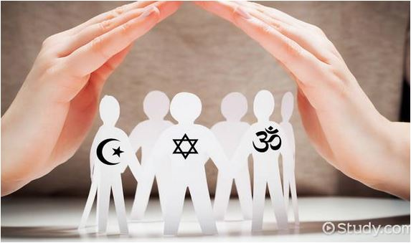
Religious Diversity
Religion
It will bring lot of benefits by getting
many view points in decision making.
But this is the most challenging diversity aspect to handle.
It has to be effectively managed by:
Training all employees to educate company policy
Be fair in giving time for religious observations
Encourage employees to accept differences
Avoid overacting to simple things and not to tolerate serious issues

Slide 10

Gender Diversity
Gender
Gender Diversity offers many benefits such as:
Widen organization’s (team’s) talent pool
Bring multiple perspectives
Enhanced collaboration
Improve staff retention
Better understand customer needs
Improve organization’s (team’s) reputation
Gender communication issues can strongly affect team interactions.
Gender communication issues can range from communication styles and perceptions, opportunities and even sexual harassment.

Slide 11
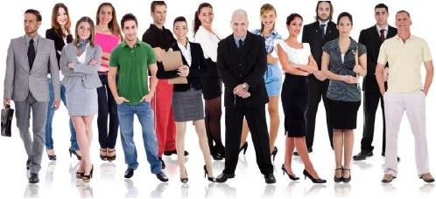
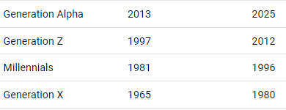
Age Diversity in a Team
Age Diversity
- Brings different mindsets, increase flexibility of team members, decisions are well rounded because of diversity in opinions, Mutually get trained, strengthen new ideas and fast execution, work-life balance

Slide 12
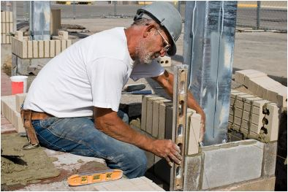
IMPORTANCE OF OLD WORKERS
1. Dedicated
2. Punctuality
3. Honesty
4. Detail-oriented,
5. Good listeners
6. Pride in a job
7. Organizational skills
8. Efficiency
9. Maturity
10. Communication skills
https://www.entrepreneur.com/article/167500

Slide 13

Why need young people
New energy and perspective
Young employees can bring fresh perspective and a different way of thinking to your business.
Workforce development
They have just come out of school or tertiary education they will still retain a mindset that will help them absorb training more readily.
Affordability
More often than not, wages for a young employee are less expensive than those for an older more experienced worker.
https://chessemployment.com.au/5-benefits-hiring-young-people/

Slide 14
Why need young people
Tech advancement & early adoption
Millennials have grown up around technology. Their natural affinity for tech and their ability to apply and understand different technologies quickly sets them apart from other generations in the workforce.
Adaptability & agility
When unexpected circumstances arise, younger people are better equipped to respond to sudden change . – Science Daily, 2011 .

Slide 15
Culture
Culture
Culture refers to the standards of social interaction, value and beliefs from a given group of people.
Cultural issues can affect team interactions through different understandings of communication or family and can appear to be an excuse for preferential treatment.

Slide 16
National culture
The set of values or beliefs that a society considers important and the norms of behavior that are approved or sanctioned in that society, Over time. the culture of a nation changes and this affects the values and beliefs of its members.

Slide 17
Popular dimensions of culture include:
Language.
Time orientation.
Use of space.
Religion.

Slide 18
Language. Edward T. Hall American anthropologist
Perhaps the most visible aspect of culture.
Whorfian hypothesis — considers language as a major determinant of thinking.
Low-context cultures — the message is conveyed by the words used.
e.g USA - northern states, Canada, German-speaking countries, Scandinavia, Poland
High-context cultures — use words to convey only a limited part of the message.
e.g. USA - southern states, China, Arab countries, Italy, Greece, Japan, Spain, Korea, India, Brazil, Russia
Video - Low and High Context Cultures

Slide 19

High-context cultures — Sri Lanka
Historians believe that the carvings of the sandakada pahana symbolise a religious meaning. The widely accepted interpretation is that of historian Senarath Paranavithana. According to Paranavitana, the sandakada pahana symbolises the cycle of Sansāra. The liyavel (center) symbolize worldly desires (Taṇhā) and the lotus depicts the final achievement of Nirvana. The elephant, bull, lion and horse depict birth, decay, disease and death respectively, while the swans symbolise the distinction between good and bad.

Slide 20
Time orientation.
Polychronic cultures.
Circular view of time.
Does not create pressure for immediate action or performance.
Emphasis on the present.
Monochronic cultures.
Linear view of time.
Creates pressure for action and performance.
Long-range goals and planning are important.

Slide 21
Use of space
Proxemics.
The study of how people use space to communicate.
Reveals important cultural differences.
Concept of personal space varies across cultures.
Space is arranged differently in different cultures.

Slide 22
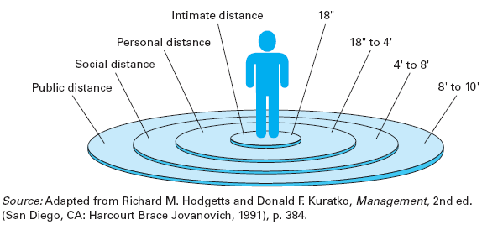
Use of space
Personal Space Categories for Those in the U.S.

Slide 23
Use of space
Personal territories, however, can vary both culturally and ethnically.
Take Saudi Arabia for example, you might find yourself almost nose to nose with a business associate because their social space equates to our intimate space. You would probably find yourself backing away trying to regain your social space while your associate persues you across the floor trying to maintain his. Finally, you would come away from the encounter thinking he was "pushy“.
If, on the other hand, you were visiting a friend in the Netherlands, you would find the roles reversed, you would be doing the chasing because their personal space equates to our social space.

Slide 24
Religion
A major element of culture.
Can be a very visible aspect of culture.
Often prescribes specific behavioral practices.
Influences codes of ethics and moral behavior.
Influences conduct of economic matters.

Slide 25
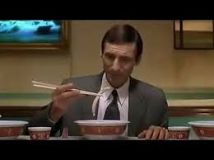

Video : HSBC Cultural differences

Slide 26
Race and Disabilities
Race
Race is defined as a group of people, often of a common geographic origin, that share genetically transmitted physical characteristics. Racism is the belief that these inherited characteristics affect an individual’s behavior or abilities.
Disabilities
Differences in ability often create difficulties in communication and emotional interactions. Whether it is a deaf individual not being able to communicate with hearing individuals, or a hearing individual being unsure of how to approach a deaf individual, disabilities present a variety of issues in team organizations

Slide 27
Benefits of Diversity in the Workplace
Here are a few of the top benefits or diversity in the workplace.
1) Talents, skills and experiences.
2) It creates innovation.
3) Language skills can open doors for a business.
4) It grows your talent pool.
5) Improves employee performance.

Slide 28
Challenges of Diversity in the Workplace
Discrimination
Stereotyping and preconception
High turnover rate
Absenteeism
Conflicts in team members
Increase tension
Productivity Decrease

Slide 29
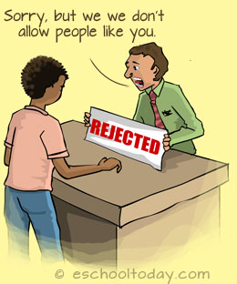
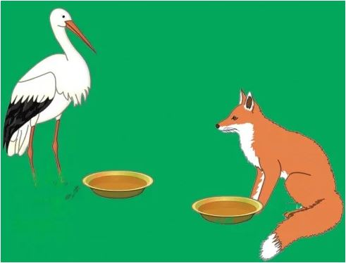
Discrimination
Discrimination means treating a person unfairly because of who they are or because they possess certain characteristics.
Age
Gender
Race
Disability
Religion
Pregnancy and maternity
Sexual orientation
Gender reassignment
Marriage and civil partnership

Slide 30
WHAT IS STEREOTYPING?
Stereotyping is defined as an "oversimplified, usually pejorative, attitude people hold toward those outside one's own experience who are different.”
A stereotype is simply a widely held belief that an individual is a member of a certain group based on characteristics.
Stereotypes are functional: As audience members we are bombarded with much more information than we can process.
Stereotypes are results of selectivity in social perception: We tend to see what we expect to see
Prejudice: This is the most influential factor in stereotyping. Our perceptions are highly subjective, and many people subscribe to derogatory descriptions of ethnic groups.

Slide 31
How to overcome diversity Issues:
Planning and Implementation
Business managers, must be able to plan and execute a diversity plan. This involves mapping out a way to create an appreciation for diversity in all employees in your office.
Conflict Resolution Skills
An essential tool to managing workplace diversity is the ability to handle conflict. Disagreements that arise because of cultural differences must be handled promptly and swiftly as to not decrease productivity in the workplace.
Communication
Good communication is one of the best ways to manage diversity in the workplace. Encourage your employees to share concerns as they arise. Every employee should feel equally important to the company.

Slide 32

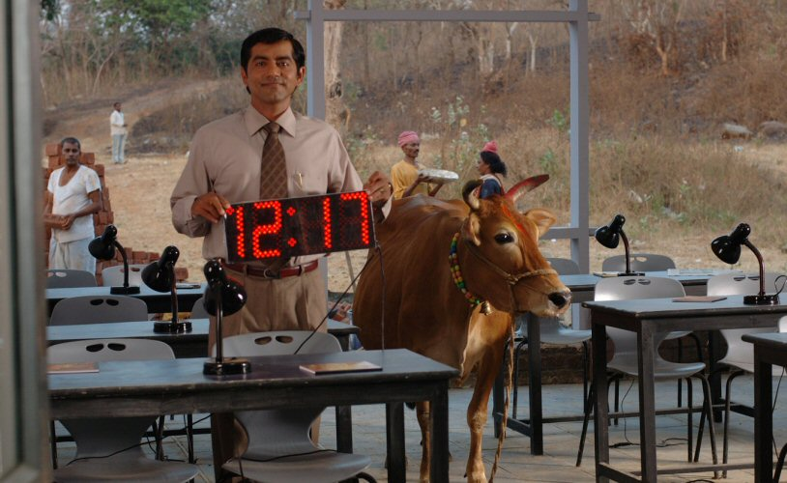
Culture shock, Cross Cultural Communication Watch the Movie – “Outsourced” from Following Link https://tinyurl.com/54zd7dpj
Outsourced is a 2006 American romantic comedy film directed by John Jeffcoat and written by Jeffcoat and George Wing.

Slide 33
Questions ?

